Slide 1
WE INDENTIFY SECURE AND INTEGRATE

Slide 2
Introduction
IRIZID
IRIZ ID Technologies
delivers Software
Solutions in the area of security systems with a combination of technical expertise, operational experience and corporate focus.
PRODUCTS & SERVICES
Ability
We offer customer solutions such as
-Card Issuance (ID Soft)
-Access Control System (ACS)
-Time and Attendance (TNA)
-Emirates ID (EID)
-RFID Tracking Solutions
and with many more customization options.
OUR MISSION
Enhancing our clients’ operational efficiency and organizational security.
Business
OUR VISION
To grow our business on the strengths and core competencies of the organization and be truly a market leader in the Secure Issuance & Physical Access arena.
Commitment

Slide 3
Products
1
2
3
IDSoft is a comprehensive ID-card creation tool used to create personnel
Identity cards as per the
organization standards.
ESS SOFT is an enterprise level web based application that is used to facilitate flow of information so business decisions can be data-driven.
Its core functionality is to send the commands, instructions, requests and data to controller and receive the response/logs from controller and notify the same to operator.

Slide 4
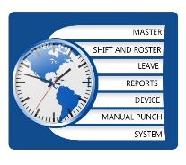
Products
4
5
6
Track Soft
The basic function of time and attendance system is to process the access grant logs to generate the attendance reports as per the standards of an organization.
EID holds all the essential information about
Individual including
biometric information,
the personal details of card holder can be read from the card and shall be converted into E-Data.
Track Soft eliminates complex things like spreadsheets, physical inventory and helps you to take control of your organization’s valuable property.
-Track Soft make asset tracking easy.

Slide 5
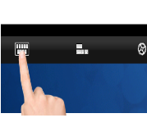
ID Soft
OVERVIEW
ID SOFT FEATURES
VERSIONS
PRE-REQUISITES
PRODUCT SCREENSHOTS
LICENSING

Slide 6
IDSoft OVERVIEW
MODULES:
Design Data
Print System
Many More…
IDSoft is a comprehensive ID-card creation tool used to create personnel identity cards as per the organization’s standard.
HI
Database management Modules facilitates user to link to data source to retrieve the personnel details and print on to the card, in the format it is designed.
FEATURES:

Slide 7
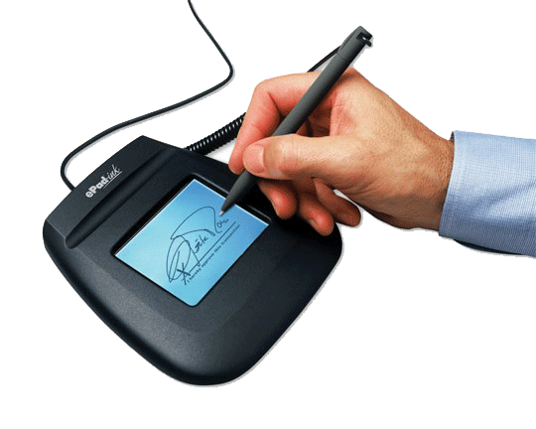
DESIGN MODULE
Following are the list of options available in design module and they are broadly categorised into two types
Static: Values
remain fixed for
all the card
holders.
Dynamic: Values
vary for every
card holder.
Shapes
Picture
Text Label (Fixed)
Label…
Value…
Text Field (variable)
Logo
Barcode
Background
QR Code
Signature(Fixed)
Signature(Variable)

Slide 8
DATA MODULE
Following are the list of options available in data module
Internal
External
File System
It uses MS Access as an
internal database to store card holder details.
It automatically creates
tables and columns
dynamically which utilizes the memory efficiently.
It also records card
holder details when card gets printed.
Application user
information also maintained in same Database.
It provides an easy and
user friendly interface to establish connection to additional data source where card holder information already exist.
Information can easily be
retrieved and printed on card.
It supports MS-Excel, MS-
Access, MS-SQL, MYSQL, Oracle and etc.. As external data source.
It creates separate
folder for each project which contains all files related to it, such as card layout, images, card printed details.
Card design (Layout) has
.idx as an extension

Slide 9
PRINT MODULE
Following are the list of options available in print module
Print
It supports all windows compatible printers
It is successfully working with well recognised ID card printers such as HID Fargo, Zebra, Smart and Magic card
Supports single or batch print option
It provides option to print single side or double side of the card
It provides option to set card orientation and standard/custom card size
Encoding
It supports inline encoding provided with easy interface to configure encoding option
Magnetic stripe
Mifare Classic (1K, 2K and 4K)
Contact Smart card (SLE 5528)
Auto Print
It is a separate utility which keeps monitoring incoming records and forward it to printer to personalise the card.
This utility also acts as an vital tool to integrate with third party application.

Slide 10
SYSTEM MODULE
Following are the list of options available in system module
User Management
It allows to create application
Users
It has easy and user friendly
interface to configure user rights such as None/Read/Admin for Design, Print, Reports, Database, Create User and User Right roles
It also provides option to
change user password
Application Settings
Reports
It also provides an interface to
configure application settings as data row height, Client, Encoder, Reader, Port number and default printer.
Comprehensive audit trial
Report gives the list of cards printed with complete details.
It provides dynamic and flexible
user definable filter options.
It provides option to export data in Excel and CSV format.

Slide 11
ID SOFT FEATURES
Uniform Positioning
1
Uniform positioning of the property tab helps user to quickly navigate among the various property settings in GUI.
Ribbon View
2
Ribbon View provides an easy access to reach the fields which are used very often in Design.
Special Fields
3
Special fields’ concept enhances filter options and keeps track of printed or non-printed cards on external database along with additional information such as print date, printed user and remarks etc.
Photo Capture
4
Photo Capture supports all WIA compatible devices and Canon digital camera to capture the photograph, embedded preview window reduces the time and other significances while capture the photo. Canon camera tested models are 1100D, 1200D, EOS 7D.
Batch Printing
5
Batch Print supports one or more cards to be printed in one click. It validates records to check for card printed status and assists user to take necessary actions.
Auto Printing
6
Auto Print provides an effective way of integrating ID card printing system with the third party application in easy steps and less effort.

Slide 12
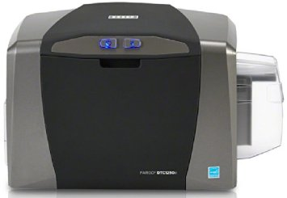
ID SOFT FEATURES
Automatic Creation
7
Automatic creation of internal database reduces the burden of creating the database and tables manually.
User Friendly
8
A user friendly interface offers easy steps to establish the connection between external databases and to link the necessary fields dynamically.
Encoding
9
Smart Card Encoding gives Quick and Easy steps to configure PC/SC, synchronous and contactless smart card encoding.
• Mifare-Classic 1K, 2K and 4K
• HID iClass 2Kbit and 16Kbit
• SLE-5528 contact memory card
Signature Capture
10
Signature Capture allows capturing the signature dynamically during enrolling process.
Scanner
11
Scanner option to scan photo and save as image.

Slide 13
ID SOFT PREREQUISITES
Prerequisites | Recommended | Minimum
Processor | 4 GHZ | 2 GHZ
RAM | 4 GB | 2 GB
OS | WIN-7 or Higher (32/64 bit) | WIN-XP-SP3
Disc space | 500-GB | 40-GB

Slide 14
PRODUCT SCREENSHOTS
Default Login Page
Home Page with Menu Grid

Slide 15
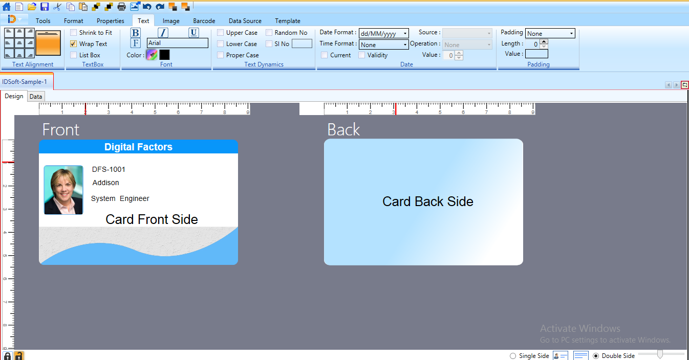
PRODUCT SCREENSHOTS

Slide 16
IDSOFT LICENSING
1
IDSoft is available in three different versions namely Basic, Classic and Professional.
BASIC, CLASSIC, PROFESSIONAL
7
8
Each version requires online registration and features gests activated based on the key used to register the application.
KEY REGISTRATION
2
SINGLE DESKTOP LICENSE
3
It is a single Desktop license, once it is installed and registered with the key provided by vendor, same key cannot be used to activate the IDSoft on another PC.
ONLINE / OFFLINE
4
PC where IDSoft needs to be installed requires Internet Connection to register the IDSOft, if no internet is available on the same PC then Offline Registration process shall be used to activate IDSoft.
Note: More details about how to activate IDSoft shall be found in user manual.
VERSION
5
Following table depicts the list of features available in each version.

Slide 17
IDSOFT LICENSING
FEATURES | BASIC | CLASSIC | PROFESSIONAL
Design Tool | ☑ | ☑ | ☑
Internal DB | MS Access | MS Access | MS Access
External DB | ☒ | MS Access/Excel | ODBC/OLEDB
Photo Capture | ☑ | ☑ | ☑
Signature Capture | ☒ | ☒ | ☑
Dual Side Print | ☑ | ☑ | ☑
Batch Print | ☒ | ☑ | ☑
Auto Print | ☒ | ☒ | ☑
QR Encoding | ☑ | ☑ | ☑
Magnetic Stripe | ☒ | ☑ | ☑
Mifare Encoding | ☒ | ☒ | ☑
Smart Card Encoding | ☒ | ☒ | ☑
UV Encoding | ☒ | ☒ | ☑
Special Fields | ☒ | ☒ | ☑
Integration | ☒ | ☒ | ☑
Audit Trail Report | ☑ | ☑ | ☑

Slide 18
THANK YOU
IRIZ ID TECHNOLOGIES
WE INDENTIFY SECURE AND INTEGRATE
Head Office and Business Center
Office # M-05 | Bin Thani Residence Building | Next to Al Hilal Bank
Al Qusais - 2 | P.O. Box: 55370 | Dubai | U.A.E
Tel: +971 4 268 5656 | E-mail: sales@irizid.com | Web: www.irizid.com

